Slide 1


Slide 2
Content
Concept of Algorithm
Algorithm Specification
Pseudo Code Conventions
Recursion and its properties
Performance Analysis(Space and Time Complexity)
Step Count
Asymptotic

Slide 3
Concept of Algorithm
An algorithm is a self-contained step-by-step set of operations to be performed.
Describe: in natural language / pseudo-code / diagrams / etc.
Criteria to follow:
Input: Zero or more quantities (externally produced)
Output: One or more quantities
Definiteness: Clarity, precision of each instruction
Effectiveness: Each instruction has to be basic enough and feasible
Finiteness: The algorithm has to stop after a finite (may be very large) number of steps

Slide 4
Algorithm Specification(Pseudo Code Conventions)
Pseudocode is a high-level representation of an algorithm that is easier to read and understand than programming language code. It is not a programming language, but rather a way to describe an algorithm in a structured and concise manner.
Indentation and Spacing
Proper indentation and spacing are crucial in pseudocode. It is essential to use a consistent number of spaces for indentation, and to leave a blank line between each section of the algorithm. This improves readability and makes the pseudocode easier to understand.
Variables and Data Types
When declaring variables, it is essential to specify the data type. This can be done using keywords such as integer, real, boolean, etc. For example:
DECLARE x AS INTEGER
DECLARE y AS REAL

Slide 5
Continue…
Control Structures
Control structures such as if-else statements, for loops, and while loops should be written in a consistent manner. For example:
IF (x > 5) THEN
PRINT "x is greater than 5"
ELSE
PRINT "x is less than or equal to 5"
ENDIF
Functions and Procedures
Functions and procedures should be written in a consistent manner, including the use of parentheses and commas. For example:
FUNCTION add(x, y)
RETURN x + y
END FUNCTION

Slide 6
Continue…
Comments
Comments are essential in pseudocode, as they provide additional information about the algorithm. Comments should be written in a consistent manner, using keywords such as // or /* */. For example:
// This is a comment
/* This is a multi-line comment */
Looping Statements:
for, while, repeat, until.
Array Element Access:
Elements of multi dimensional array are accessed using []. For exmalpe
ar[i,j]

Slide 7
Recursion
A function calling itself.
int function(int value) {
if(value < 1)
return;
function(value - 1);
printf("%d ",value);
}
Properties
A recursive function can go infinite like a loop. To avoid infinite running of recursive function, there are two properties that a recursive function must have −
Base criteria − There must be at least one base criteria or condition, such that, when this condition is met the function stops calling itself recursively.
Progressive approach − The recursive calls should progress in such a way that each time a recursive call is made it comes closer to the base criteria.

Slide 8
Tower of Hanoi Using Recursion
Problem Statement : Tower of Hanoi is a mathematical puzzle where we have three rods (A, B, and C) and N disks. Initially, all the disks are stacked in decreasing value of diameter i.e., the smallest disk is placed on the top and they are on rod A. The objective of the puzzle is to move the entire stack to another rod (here considered C), obeying the following simple rules:
Rules:
Only one disk can be moved among the towers at any given time.
Only the "top" disk can be removed.
No large disk can sit over a small disk.
Algorithm:
Step 1 − Move n-1 disks from source to aux
Step 2 − Move nth disk from source to dest
Step 3 − Move n-1 disks from aux to dest
START
Procedure Hanoi(disk, source, dest, aux)
IF disk == 1, THEN
move disk from source to dest
ELSE
Hanoi(disk - 1, source, aux, dest) // Step 1
move disk from source to dest // Step 2
Hanoi(disk - 1, aux, dest, source) // Step 3
END IF
END Procedure
STOP

Slide 9
Performance Analysis(Space and Time)
The complexity of an algorithm is simply the amount of work the algorithm performs to complete its task.
Space complexity
How much space is required
Time complexity
How much time does it take to run the algorithm

Slide 10
Space Complexity
Its the amount of memory space required by the algorithm, during the course of its execution.
Space complexity must be taken seriously for multi-user systems and in situations where limited memory is available.
An algorithm generally requires space for following components :

Slide 11
Continue…
✔ Instruction Space : Its the space required to store the executable version of the program. This space is fixed, but varies depending upon the number of lines of code in the program.
✔ Data Space : Its the space required to store all the constants and variables value.
✔ Environment Space : Its the space required to store the environment information needed to resume the suspended function.

Slide 12
Time Complexity
Time Complexity is a way to represent the amount of time needed by the program to run to completion.
Often more important than space complexity
space available tends to be larger and larger
time is still a problem for all of us
Algorithms running time is an important issue.

Slide 13
Continue…
Calculating Time Complexity:
Now the most common metric for calculating time complexity is Big O notation. This removes all constant factors so that the running time can be estimated in relation to N, as N approaches infinity.
In general you can think of it like this :
statement;
Above we have a single statement. Its Time Complexity will be Constant. The running time of the statement will not change in relation to N.

Slide 14
Continue…
for(i=0; i < N; i++)
{
statement;
}
The time complexity for the above algorithm will be Linear. The running time of the loop is directly proportional to N.

Slide 15
Continue…
for(i=0; i < N; i++)
{
for(j=0; j < N;j++)
{
statement;
}
}
This time, the time complexity for the above code will be Quadratic. The running time of the two loops is proportional to the square of N. When N doubles, the running time increases by N * N.

Slide 16
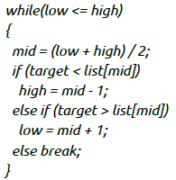
Complexity
This is an algorithm to break a set of numbers into halves, to search a particular field.
Now, this algorithm will have a Logarithmic Time Complexity. The running time of the algorithm is proportional to the number of times N can be divided by 2 (N is high-low here). This is because the algorithm divides the working area in half with each iteration.

Slide 17
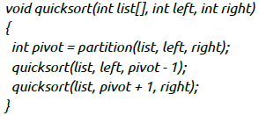
Continue…
Taking the previous algorithm forward, above we have a small logic of Quick Sort (we will study this in detail later). Now in Quick Sort, we divide the list into halves every time, but we repeat the iteration N times(where N is the size of list).
Hence time complexity will be N*log( N ). The running time consists of N loops (iterative or recursive) that are logarithmic, thus the algorithm is a combination of linear and logarithmic.

Slide 18
Continue…
Note:
In general, doing something with every item in one dimension is linear.
Doing something with every item in two dimensions is quadratic, and
Dividing the working area in half is logarithmic.

Slide 19
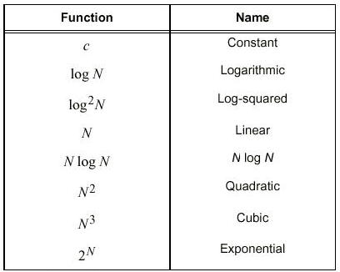
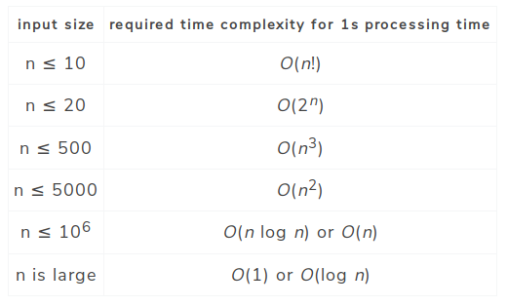
Complexity: Function of Growth rate

Slide 20
Continue…
Time for an algorithm to run t(n):
A function of input. However, we will attempt to characterize this by the size of the input. We will try and estimate the WORST CASE, the BEST CASE, and the AVERAGE CASE.
Worst Case:
is the maximum run time, over all inputs of size n. That is, we only consider the "number of times the principle activity of that algorithm is performed".
Best Case:
In this case, we look at specific instances of input of size n. For example, we might get best behavior from a sorting algorithm if the input to it is already sorted.

Slide 21
Continue…
Average Case:
Arguably, average case is the most useful measure.
Since the algorithm's performance may vary with different types of input data, hence for an algorithm we usually use the worst-case Time complexity of an algorithm because that is the maximum time taken for any input size.

Slide 22
Continue…
Types of Notations for Time Complexity:
1) Big Oh denotes "fewer than or the same as" <expression> iterations (worst-case).
2) Big Omega denotes "more than or the same as" <expression> iterations.
3) Big Theta denotes "the same as" <expression> iterations.
4) Little Oh denotes "fewer than" <expression> iterations.
5) Little Omega denotes "more than" <expression> iterations.

Slide 23
Continue…
Understanding Notations of Time Complexity with Example:
O(expression) is the set of functions that grow slower than or at the same rate as expression.
Omega(expression) is the set of functions that grow faster than or at the same rate as expression.
Theta(expression) consist of all the functions that lie in both O(expression) and Omega(expression).
Suppose you've calculated that an algorithm takes f(n) operations, where,
f(n) = 3*n^2 + 2*n + 4. // n^2 means square of n
Since this polynomial grows at the same rate as n^2, then you could say that the function f lies in the set Theta(n^2). (It also lies in the sets O(n^2) and Omega(n^2) for the same reason.)

Slide 24
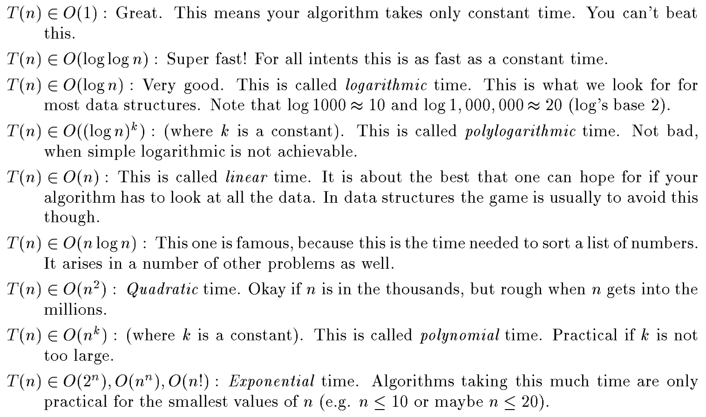
Continue…

